Slide 1
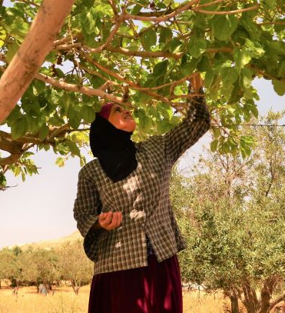
YOUR FRIENDSHIP LINK HERE
BRITAIN PALESTINE FRIENDSHIP AND TWINNING NETWORK

Slide 2
PRESENTATION TITLE
Name of presenter

Slide 3
Why Palestine?
Political solidarity?
Professional solidarity?
Religious solidarity?
Other reasons?

Slide 4
Friendship and twinning: add your grop name here
What Friendship and twinning involves
Which you have chosen and why
A little about your group
How long has it been going?
Who is involved?- Your members and committee
What do you do?

Slide 5
About your link group
Who are your friends/twins?
Why do you choose each other?
What do they expect from you?
What do you expect from them?

Slide 6
About the Britain Palestine Friendship and Twinning Network
(insert your) group is part of a UK - Palestine wide network of ~ 35 different friendship and twinning groups
Groups vary in size, location, activities and approaches but all have in common the aim of building friendships and acting in solidarity with the Palestinian people.
The network offers X and supports the group with Y (add in how you engage with the network)
You can find out more on the BPFTN website (https://www.twinningwithpalestine.net/)

Slide 7
Real people, real stories, real friendships
1-2 stories of those affected by the Occupation, or the story of the community
A moving story, video or audio clip,
about the people and the place you’re twinning with will help to
engage people

Slide 8
Photos

Slide 9
Recent activities
Visits to Palestine
Visits from Palestine
Drama/music?
Activism?
Articles?

Slide 10
Future plans
Visits?
Fundraising?
Projects?
Petitions?

Slide 11
Get involved
What can UK members gain from the group?
What can both groups gain from the friendship/twinning?
What can members give to the group and the friends/twins?
What people in Palestine have told us
What the group in the UK needs to run / keep going
Practical ways to support

Slide 12
Questions

Slide 13
Get in touch!
Display your details and how people can follow up with you.
If you have a website you could include it here
Or point people towards places they can take action on human rights issues in Palestine.

Slide 14
(Add a final thought or quote about Palestine or your group’s activities)
“It's meeting the people, and hearing their stories, that really brings the situation to life”
MAKE FRIENDS
BUILD SOLIDARITY
INSPIRE HOPE
palestinetwinning.net

